Slide 1
Sentiment Analysis on Yelp Reviews
Sai Sneha Yachamaneni

Slide 2
Goals of the Project:
Learn and enhance skills on Scala programming, IntelliJ IDE and Sensitivity Analysis
Meet deadlines of each sprint and activities associated with it
Improve problem solving skills and approach toward real world problems

Slide 3
Acceptance Criteria
Being able to extract the review out of input fields and predicting the sentiment correctly or closer to actual sentiment
Achieving 70% accuracy

Slide 4
Use Case
Actor : System
Action : Processing data and feeding to sentiment analyzer
Reaction : Sentiment of each review gets updated

Slide 5


Background
Yelp helps businesses like restaurants, hotels etc to establish their business page on their website
Public provide their reviews about the service provided by businesses from their personal experience
By performing sentiment analysis on reviews , Yelp can help or helps businesses by providing suggestions to businesses for making better decisions

Slide 6
Data Description
Data Source : As part of Yelp data challenge, Yelp has provided data which consists of various JSON files
Primary file is review.json which consists of 6 million records (4.5 GB)
Subset the dataset to 5000 records

Slide 7
Methodology
Data
Load
Extraction
Sentiment
Analyzer
Transformation
Consolidation
Testing Logic

Slide 8
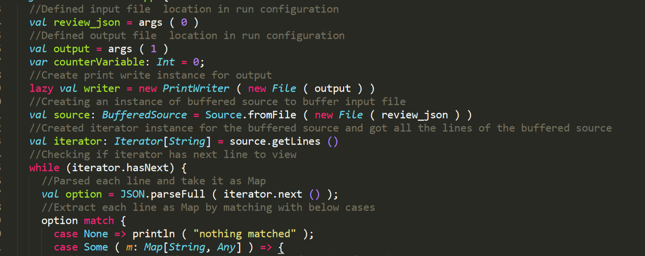
Code Snippets

Slide 9
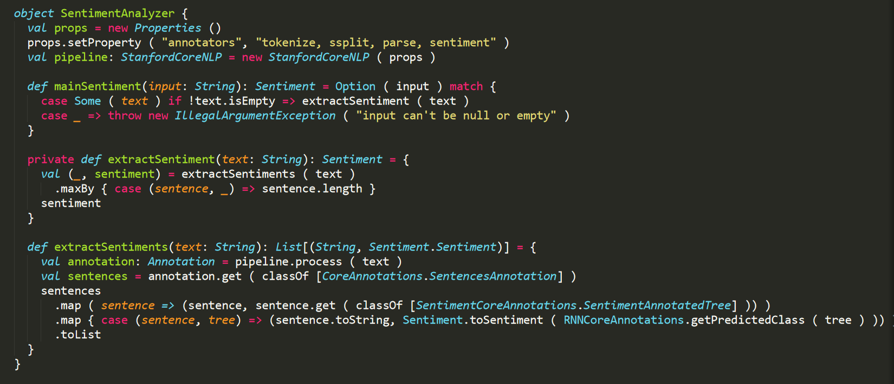
Code Snippets

Slide 10
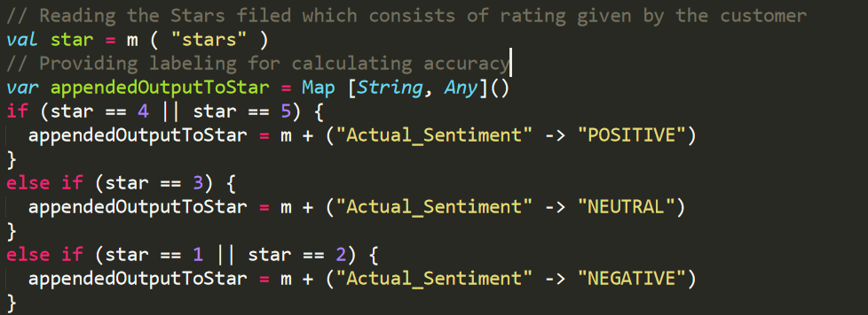
Testing
Input data do not consist of Actual Sentiment labels
For testing purpose came up with below logic

Slide 11
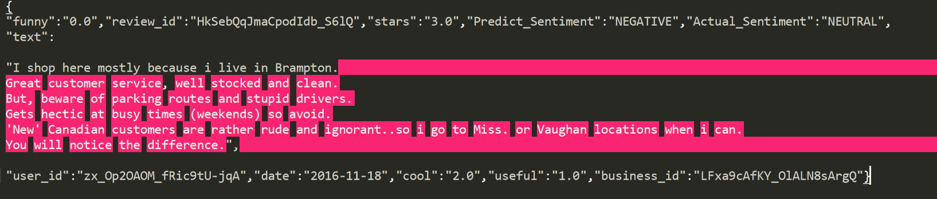
Reasons For…
Why testing logic is not apt
Why considering first sentence is not a good choice

Slide 12
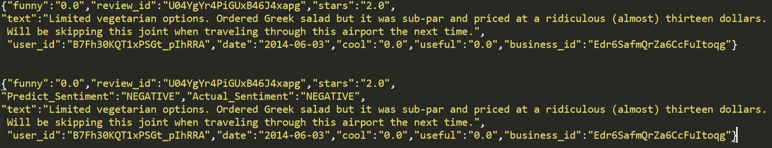
Input/Output Sample Record

Slide 13
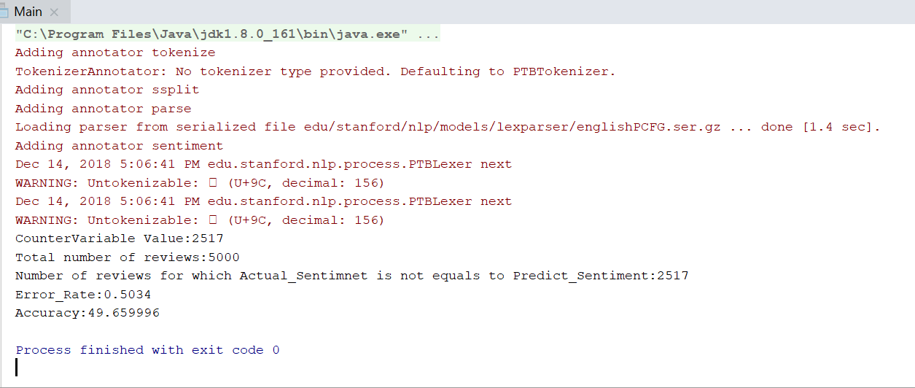
Accuracy Results

Slide 14
Future Steps and Reference Links
Future Steps:
Improving accuracy and predicting sentiments like Sarcasm/Humour etc
Trying to process text in faster way which helps doing sentiment analysis for large datasets
References:
https://shekhargulati.com/2017/09/30/sentiment-analysis-in-scala-with-stanford-corenlp-2/https://www.yelp.com/dataset/documentation/main
https://github.com/snehayachamaneni/scalaproject

Slide 15
Thank You !

